Slide 1

PHISHING AWARENESS TRAINING
Mugeha

Slide 2

Understanding Phishing
Identify
Identify Phishing
Learn
Learn to recognize the signs of phishing attempts, including suspicious email addresses, grammatical errors and urgent requests for personal information to protect yourself.
Report
Report suspicious emails
Encourage
Encourage individuals to report suspicious emails to IT support or management immediately, helping to mitigate potential threats and reinforce a culture of security awareness.

Slide 3

Understanding Phishing: Definition and Types
Recognize the various phishing techniques such as spear phishing, whaling and vishing. Implement multi-factor authentication and regular security training to strengthen defenses against targeted attacks, ensuring employees are equipped to identify and report suspicious communications promptly.

Slide 4


Common Phishing techniques and tactics
Email Spoofing
Check sender's email address thoroughly to confirm it matches official domains before responding.
Malicious Links
Hover over links to preview URLs without clicking, and verify them with official websites.
Urgent Requests
Be cautious of unexpected messages using immediate actions; always verify through trusted communication channels.

Slide 5
Recognizing Phishing Attacks in Emails
Check Sender
Ensure the sender's email is familiar and legitimate.
Look for Errors
Be cautious of spelling or grammatical mistakes in the message.
Attachments Caution
Never open attachments from unknown or suspicious sources.
Too Good to be True
Be skeptical of emails offering unrealistic deals or prizes.
Monitor Links
Hover over the links to see if they lead to trusted websites.
Urgency Tactics
Beware of emails that create a false sense of urgency to act quickly.
Verify Requests
Check if request for personal information seem legitimate.

Slide 6

Spotting Phishing Websites and Links
Check URL
Ensure the website URL matches the legitimate site, including spelling and domain extensions.
Look for HTTPS
Confirm that the website uses HTTPS, without it, your data might not be secure.
Text Here
Evaluate the website design, poorly designed sites often indicates a phishing attempt.
Review Contact Information
Legitimate websites provide clear contact details: phishing sites usually lacks this information.
Verify Email Source
Always verify that the email source requesting your information is legitimate before clicking links.

Slide 7

The Role of Social Engineering in Phishing
Trust Exploitation
Attackers exploit established trust relationships for deceptive communication.
Urgency Tactics
Create a false sense of urgency to elicit immediate responses from targets.
Text Here
Use personal details to make phishing attempts appear more authentic.
Mimic legitimate entities to manipulate victims into revealing sensitive data.
Leverage fear, curiosity, or sympathy to push victims into compliance.

Slide 8
Real World Phishing Case Studies
Problem Faced
Employees fell for a fake bank email scam.
Solution Offered
Implementing a multi-layered email filtering system
Benefits
Reduced phishing attempts by 80% instantly.

Slide 9
Effective Strategies To Prevent Phishing
Verify Sources
Always confirm the identity of the sender before responding.
Use Strong Passwords
Implement complex passwords and change them regularly to enhance security.
Report Suspicion
Immediately report any suspicious emails to your IT department.
Educate Staff
Regular training sessions improve awareness and reduce risk of phishing.

Slide 10
Implementing Cybersecurity Policies and Procedures
Assess
Evaluate current cybersecurity risks and vulnerabilities
Develop
Create comprehensive cybersecurity policies and protocols.
Train
Provide employees with an education on security practices.
Implement
Enforce policies across all levels of the organization.
Monitor
Regularly check compliance with cybersecurity measures.
Update
Revise policies as threats and technology evolve
Test
Conduct exercises to assess response to incidents
Review
Continuously evaluate the effectiveness of policies.

Slide 11
Reporting Phishing Attempts: Best Practices
Verify Sender
Always check the email address and its domain for legitimacy.
Do Not Click
Avoid clicking on any links or downloading attachments in suspicious emails.
Report Immediately
Notify your IT department or designated personnel as soon as possible.
Provide Details
Include all relevant information such as eamil headers and content
Educate Others
Inform co-workers or team members about the phishing attempt you received.
Secure Devices
Ensure your devices have updated anti-virus and security software in place.
Follow Protocol
Adhere to organization's specific procedures for reporting phishing incidents.

Slide 12
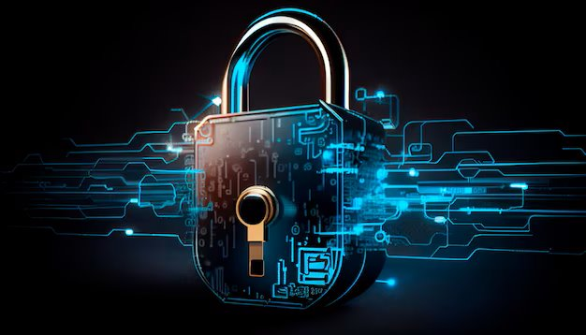
Future Trends in Phishing Attacks and Defense
AI techniques
Utilizing AI for detecting and analyzing phishing patterns effectively.
Multi-Factor Authentication
Implement multi-factor authentication to mitigate unauthorized access risks.
Email Filtering
Adopt advanced email filtering systems to block phishing attempts automatically.
User Training
Conduct regular training sessions to aware users about phishing tactics
Incident Response Plans
Establish clear incident response protocols for phishing incidents.
Threat Intelligence Sharing
Engage in threat Intelligence sharing to stay updated on phishing trends.
Regular Software Updates
Ensure all software is kept up to date to fix known vulnerabilities.

Slide 13

THANK YOU
Contact Number
0757657334
Email Address
jacklinemugeha@gmail.com

